Slide 1
Introduction to Network Programmability and The Management Interface, The Application-Network Divide
SESSION 4
Ref. 2, Ch.5 (Page. 117 to Page 121)

Slide 2
Introduction
The concept of programmability can exist in a number of network devices and software components
What differs now is in specifically how those devices exist in real or virtual are not only managed, but also interacted with. Regardless of the type of target, the goal is to make it easily programmable and to facilitate a bidirectional channel of communication between it and the other piece of software communicating with it.
This forms what we refer to as a tightly coupled feedback loop between these elements.
This concept is in fact quite different from the traditional network management paradigm, where the manager and agent communicated in a relatively loose fashion with considerable lag between operations—including cases where essentially no feedback existed.

Slide 3
Interface and their requirements
In order to realize this new paradigm of communication and interaction, tightly coupled, bidirectional programmatic interfaces are needed.
These interfaces also need to be readily and rapidly implemented in software so as to encourage their use and ubiquitous deployment.
These interfaces have been commonly referred to as application friendly.
These interfaces also need to be developed by communities of developers in order to make them robust, secure, and widely used.
Interfaces need to provide self describing capabilities so that applications can easily and dynamically learn and understand the capabilities of a network element without having to be recompiled.
The net effect then will be interfaces that one can safely code to and that are portable across different controller platforms.

Slide 4
The Management Interface
Management interfaces allow network operators to manage network devices in their networks
These interfaces generally provide the operator with a consistent operational view of a device, including its configuration and operational status.
A management interface typically consists of two key elements: a protocol and a message format specification.
PROTOCOLS:
This describes the syntax and semantics associated with sending or receiving specific messages that either the manager or network element generates.
These messages often contain commands, queries, or responses to earlier queries.
In some cases, these messages can be emitted without a direct query—as is the case with events (notifications) that are emitted asynchronously in response to some event within the network element

Slide 5
MESSAGE FORMAT AND THE MEANING OF MESSAGES:
Some management interfaces define a data model that can be used as a directory of information available to the network operator.
In some cases, these can also be used to describe how a manager might construct queries or commands between it and the device.
The data model also typically describes the relationship between manageable objects within the system. For example, the system’s name might be kept in an object called sysName and associated with another object called sysUpTime indicating the length of time the system has been running.
Both of these objects would be related in that they are contained within the parent object called system, which represents the entire system.

Slide 6
Intro to Application-Network Divide
Most modern network elements (e.g., routers, switches, or firewalls) supported a small set of traditional interfaces that were used to communicate with those elements.
These typically included a proprietary command-line interface (CLI), SNMP, CORBA, and more recently, some form of NETCONF.
These languages have a few key traits: they are very static in nature and require a priori data model design and declaration.
interfaces used to converse with a network element had to be pre programmed rather than being learned on-the-fly
syntax of the languages used to define the structure of messages purpose-built protocols often used binary encodings-compact on the wire, but difficult to program

Slide 7
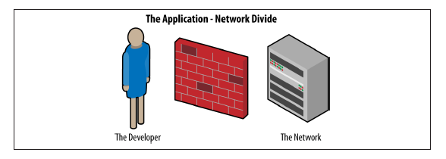
Application-Network Divide
Element management system (EMS) acted as a proxy between the network elements and the applications.
Unfortunately, the EMS (or NMS) generally did not expose the network elements or the services they provided in any sort of application friendly way
meaning that coding toward these interfaces and paradigms was cumbersome and ultimately resulted in long periods of time between an application signaling
its desire to do something and that something actually happening. This is we call as application-network divide as illustrated in Figure

Slide 8
Solution for solve cumbersome coding
i) use interfaces that are application-friendly RESTful (representational
state transfer) interfaces.
ii) These interfaces are generally defined using modern approaches such as JSON (JavaScript Object Notation).
JSON solves many of the shortcomings just described because
its schema is defined using human-readable XML
self-referential
hierarchical
easily built into Java applications—the most common application programming language

Slide 9
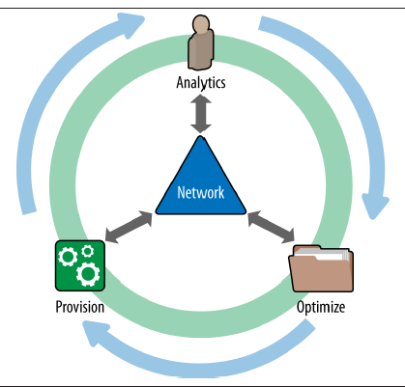
Closely coupled interaction between applications and the network elements
The application-network feedback loop provisioning, analysis, and optimization represent three common and general actions
Act of provisioning : an application indicates a desire to do something, change something, or generally affect the behavior of the network
The analysis phase : one of monitoring or gathering feedback from network elements as to their operational, fault, capacity, or otherwise well-being states. This includes, for example, statistics gathering or reception of status notifications
optimization :the last stage that is accomplished using the information gathered from the analysis phase and possibly causes another act of provisioning to take place (potentially through some embedded or external policy engine interaction) in order for the system to adjust itself in order to better operate.

Slide 10
Modern Programmatic Interfaces- Publish and Subscribe Interfaces, XMPP, Google’s Protocol Buffers , Thrift ,JSON
Ref. 2, Ch.5 (Page. 132 to Page 143)

Slide 11
Modern Programmatic Interfaces
new interfaces and concepts are those that enable and encourage network programmability in the best sense.
These interfaces exhibit most if not all of the key attributes we spelled out in the introduction earlier: bidirectional, application-friendly, and self-describing.
They also incorporate robust data models that can translate into data-driven behavior and rapid implementation, and of course are easily developed by communities of developers.

Slide 12
Publish and Subscribe Interfaces
Publish-Subscribe interfaces, or simply pub-sub as it is more commonly known, is a messaging pattern whereby senders of messages (called publishers) send messages to receivers (called subscribers)
Senders do not program the messages to be sent directly to specific receivers but rather characterize published messages into classes.
In this model, subscribers express interest in one or more classes, and thereby only receive messages that are in the class of messages they are interested in.
messaging bus is a method in which messages are placed on the bus, and subscribers simply receive them.
This pattern provides greater network scalability and a more dynamic network topology than a point-to-point system would due to properties such as lower state management requirements.
subscribers typically receive only a subset of the total messages published. it simultaneously lowers the burden of an application around message processing and lessens the overall system load of message delivery, maintenance, and accounting.
The process of selecting messages for reception and processing is called message filtering. The two common forms of filtering are called topic-based and content-based.

Slide 13
topic-based & content-based system
publishes messages to topics that represent logical sets or are analogous to logical channels in a broadcast system. Subscribers in a topic-based system will receive all messages published to the topics to which they subscribe, but no others.
a content-based system only delivers messages to a subscriber if the attributes or content of those messages match constraints defined by the subscriber. This is analogous to setting up search filters for email messages with matches on certain fields of a message.
many messaging systems support a hybrid of the two approaches in that publishers can post messages to a topic, and subscribers may simultaneously register content-based subscriptions to topics
broker based: publishers post messages to an intermediary message broker or event bus. The broker normally performs a store and forward function in order to buffer messages so that they are not lost in case of congestion
Some frameworks and software products use XML configuration files to register subscribers, providing what we have been calling a data-driven approach that can dynamically adjust depending on system attributes, configuration, or local conditions.

Slide 14
Advantages and disvantages
The pub-sub model provides the opportunity for better scalability than traditional tightly coupled client-server approaches in that parallel operation, message caching, and tree-based or network-based routing are possible within this system
One of most serious problems with the pub-sub approach is the decoupling of the publisher from the subscriber pub-sub system so-designed cannot guarantee delivery of messages to any applications that might require such assured delivery.
If publishers or subscribers are unaware of this limitation, then synchronization and other consistency issues might arise.

Slide 15
XMPP
Extensible Messaging and Presence Protocol (XMPP) is an example of a pub-sub protocol and has been used to implement a number of publish subscribe systems.
XMPP is a communications protocol based on XML [Extensible Markup Language] .
The protocol can be used to provide near real-time instant messaging, presence information, or just about any information really that needs to be extended to a subscription group.
XMPP is an open protocol standardized at the IETF
Many implementations have been developed and distributed that are in use, such as Jabber, Google Talk, and Facebook Messenger
The server itself acts like the message broker we described in the pub-sub section. It handles all of the registration and message passing required.
Publishers and subscribers all register with the server using a topic based approach in that they filter based on participating in what is effectively a group conversation
The architecture is decentralized by design in that there is no global authoritative server In the XMPP architecture, every user in the system has a unique Jabber ID.
We use the term user here loosely, as it really is either an application that acts as a publisher, subscriber, or both in the pub-sub paradigm.
In the original specification, XMPP could use HTTP in two ways: either in polling mode or in a binding model.

Slide 16
Google’s Protocol Buffers
Protocol buffers are Google’s language-neutral, platform-neutral, extensible mechanism for serializing structured data. Google invented protocol buffers as a refinement to deficiencies their coders found in both XML and JSON.
The major refinement of protocol buffers has been to make XML smaller and denser through the use of a binary encoding. One of the downsides to using XML is that while it is presented in a human-readable format, it is quite verbose in terms of the amount of characters that need to be transmitted to convey the same information that one would with a comparative binary format.

Slide 17
There is a single way of defining a structured data format that then is exchanged and serialized in protocol buffers. This is done by defining a buffer message type in a .proto file.
message PersonalRecord {
required string nameFirst = 1;
required string nameLast = 2;
required string streetAddress = 3;
optional string emailAddress = 3;
enum PhoneType {
MOBILE = 0;
HOME = 1;
WORK = 2;
HOME_OFFICE = 3;
}
message PhoneNumber {
required string internationalNumber = 1;
optional PhoneType type = 2 [default = MOBILE];
}
repeated PhoneNumber phone = 4;
}

Slide 18
Once messages have been defined, one of the protocol buffer compilers is run for a particular target language.
This compiler is fed the .proto file or files as input, and that generates data access classes. Part of this process generates access functions for each field (i.e., query() or set_query()) as well as methods to serialize or parse the already defined data structures to/from raw bytes
Getting back to the example, if you examine the newly generated C++ code, you can imagine populating these classes and using them to transmit a message such as the following:
PersonalRecord personalRec;
personalRec.set_name("David Blowfish");
personalRec.set_id(420420420420);
personalRec.set_email("blowfish@lovestogrowgrapes.com");
fstream output("someFile", ios::out | ios::binary);
personalRec.SerializeToOstream(&output);

Slide 19
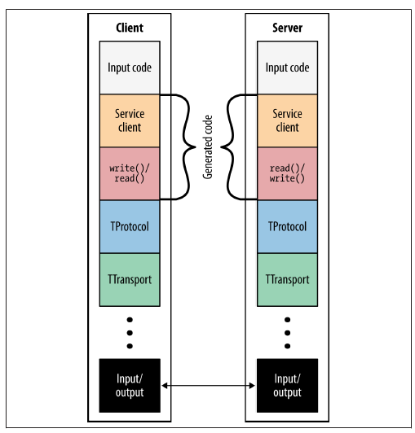
Thrift
Thrift is an interface definition language that is used to define and create services for numerous languages.
Like protocol buffers, it too is used as a remote procedure call (RPC) framework. Like protocol buffers, Thrift was developed to address the growing needs of a burgeoning application content service provider—Facebook.
Fig shows the functional architecture of a Thrift client and server. The service client and read()/write() code is generated from the Thrift service definition file.
This file is fed to the Thrift compiler that then generates client and processor code that is later incorporated into the client and server code.
The protocol and transport layer shown in the figure are part of the runtime library that comes as a precompiled library included into the client and server base.
The Apache Thrift API client/server architecture

Slide 20
example of a Thrift service description
This is an example of a Thrift service description file:
enum PhoneType {
HOME,
WORK,
MOBILE
}
struct Phone {
1: i32 id,
2: string phoneNum,
3: PhoneType type
}
As you can see, this code is quite similar to how structures would be defined in C++, which (for those familiar with that language) should be straightforward.

Slide 21
JSON
JavaScript Object Notation, or JSON as it is more commonly known as, is a lightweight data-interchange format.
One of the main appeals of JSON is that being based on XML, it is easy for humans to read and write.
It is relatively easy for machines to parse and generate. JSON is a text format that is completely language independent but uses conventions that are familiar to programmers of the C-family of languages, including C, C++, C#, Java, JavaScript, Perl, and Python.
{"menu": {
"header": "SVG Viewer",
"items": [

Slide 22
{"id": "Open"},
{"id": "OpenNew", "label": "Open New"},
null,
{"id": "ZoomIn", "label": "Zoom In"},
{"id": "ZoomOut", "label": "Zoom Out"},
{"id": "OriginalView", "label": "Original View"},
null,
{"id": "Quality"},
{"id": "Pause"},
{"id": "Mute"},
null,
{"id": "Find", "label": "Find..."},
{"id": "FindAgain", "label": "Find Again"},
{"id": "Copy"},
{"id": "CopyAgain", "label": "Copy Again"},
{"id": "CopySVG", "label": "Copy SVG"},
{"id": "ViewSVG", "label": "View SVG"},
{"id": "ViewSource", "label": "View Source"},
{"id": "SaveAs", "label": "Save As"},
null,
{"id": "Help"},
{"id": "About", "label": "About Adobe CVG Viewer..."}
] }}

Slide 23
Interface to the Routing System (I2RS)
First, the interface is a modern programmatic interface much in the sense that we have been discussing in this chapter (meaning that it is asynchronous and offers fast, interactive access). It should be self-describing and easily consumed and/or manipulated by modern applications and programming methods.
Second, the I2RS gives access to information and state that is not normally modeled or manipulated by existing implementations or configuration protocols. For example, this might be the active forwarding table of a device.
Third, the I2RS gives applications the ability to learn additional, structured information, such as topology and events, from a device. This information will be offered in a manner that is filterable in order to support flexibility, scalability and ease of consumption by applications.

Slide 24
I2RS 143 Modern Orchestration- OpenStack, CloudStack, puppet
Ref. 2, Ch.5 (Page. 143 to Page 155)

Slide 25
Modern Orchestration
OpenStack
OpenStack is a global collaboration whose aim is to produce the open standard cloud operating system for both public and private clouds. OpenStack is a freely available, Apache-licensed software system that can be used to build massively scalable cloud environments.
Nova is open source software designed to provision and manage large networks of virtual machines, creating a redundant and scalable cloud-computing platform.
The software provides control panels and APIs required to orchestrate a cloud
Nova is written in Python
Components of the OpenStack architecture

Slide 26
Swift and Cinder is open source software for creating redundant, scalable data storage using clusters of standard servers to store multiple blocks of accessible data.
It is not a file system or real-time data system, but rather a long-term storage system for large amounts of static data that can be retrieved or updated. Object Storage uses a distributed architecture in order to not have a central point of failure. This also affords the user greater flexibility of deployment options, as well as the obvious scalability, redundancy, and performance.
Glance provides discovery, registration, and delivery services for virtual disk images. The Image Service API server provides a well-defined RESTful web services interface for querying information about virtual disk images.
These disk images may be stored in a variety of backend stores, including OpenStack Object Storage. Clients can register new virtual disk images with the Image Service, query for information on publicly available disk images, and use the Image Service’s client library for streaming virtual disk images. These images can then be referenced later much in the way a menu of dishes can be made available to a diner in a restaurant.
Quantum provides the API that builds required network connectivity between Open‐ Stack physical nodes (i.e., between the vNICs managed by Openstack Nova—providing them network as a service functionality).

Slide 27
CloudStack
CloudStack is a Cloud Orchestration platform that pools computing resources to build public, private, and hybrid Infrastructure as a Service (IaaS) clouds.
CloudStack is very similar to OpenStack in that it manages the network, storage, and compute nodes that make up a cloud infrastructure.
A CloudStack cloud has a hierarchical structure that enables it to scale to manage large numbers of physical servers, all from a single management interface.
The CloudStack architecture is comprised of some basic elements: pods, clusters, and secondary and primary storage.
A pod is hardware that has been configured to form clusters. A pod is most usually a data center rack containing one or more clusters and connectivity to a layer 2 switch that is shared by all clusters in that pod. It is important in the CloudStack architecture that end users are unaware of and have no visibility of pods.

Slide 28
A cluster is a group of identical hosts running a common hypervisor. For example, a cluster could be a VMware cluster pre-configured in vCenter.
Each cluster has a dedicated primary storage device. This storage device is where the virtual machine instances are hosted and launched from. With multiple hosts within a cluster, high availability and load balancing are standard features of a CloudStack deployment
The secondary storage system is used to store virtual machine templates, ISO images, and snapshots. These are used later to launch instances of VMs. The storage is available to all pods in a zone.
Storage can also be replicated between availability zones, thereby providing a common storage platform throughout the whole cloud. This can also be automated.
Primary storage is unique to each cluster and is used to host the virtual machine instances.
Since primary storage is a critical component, it is often built on highperformance hardware with multiple high-speed disks that afford the system an element of both redundancy and higher-performance.
Secondary storage uses the Network File System (NFS). NFS is a widely deployed filesystem with built-in networking capabilities, thus any host in the zone can access CloudStack storage.

Slide 29
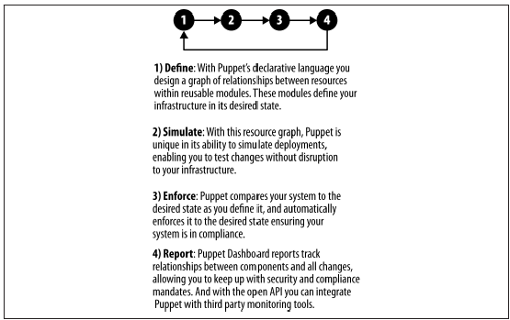
Puppet
Puppet DevOps high-level management cycle
Puppet is one of a group of IT automation software tools that help system administrators manage infrastructure throughout its lifecycle, from provisioning and configuration to patch management and compliance
See Figure for a sketch of the Puppet DevOps management cycle. Puppet allows IT administrators to automate repetitive tasks, quickly deploy critical applications, and proactively manage change servers

Slide 30
Puppet uses a declarative, model-based approach to IT automation. This language allows an IT administrator to easily define the desired state of the infrastructure’s configuration using Puppet’s declarative configuration language.
It allows an administrator to simulate configuration changes before enforcing them. It enables the enforcement of the desired state of deployed infrastructure automatically.
Administrators can use this to correcting any configuration changes as well. Finally, Puppet provides reports for an administrator that can then be used to detect differences between actual and desired states and any changes made to enforce the desired state of infrastructure.

Slide 31
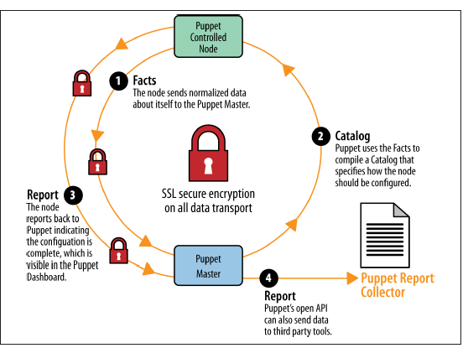
Puppet configuration/provisioning cycle (specific)
Once configured, the Puppet agent on each infrastructure node communicates regularly with the Puppet master server to automatically inform it of its state.
The Puppet master can then choose to enforce the desired states of the nodes by instructing them to do so, or simply monitor and report their deviations from the expected configurations.
The Puppet agent on the node sends what the Puppet architecture calls facts or data about the node’s state back to the Puppet master server.
This is done at regular intervals, or based on an event occurring. Using these facts, the Puppet master server compiles what is referred to as a catalog, or a detailed data set about how the node should be configured.
This information is periodically sent back to the Puppet agent. See Figure for a sketch of the Puppet configuration/provisioning cycle.

